Slide 1

Parallel Computing
Ulrike Meier Yang
Lawrence Livermore National Laboratory, P. O. Box 808, Livermore, CA 94551
This work performed under the auspices of the U.S. Department of Energy by Lawrence Livermore National Laboratory under Contract DE-AC52-07NA27344
LLNL-PRES-463131

Slide 2
References
“Introduction to Parallel Computing”, Blaise Barney https://computing.llnl.gov/tutorials/parallel_comp
“A Parallel Multigrid Tutorial”, Jim Jones https://computing.llnl.gov/casc/linear_solvers/present.html
“Introduction to Parallel Computing, Design and Analysis of Algorithms”, Vipin Kumar, Ananth Grama, Anshul Gupta, George Karypis
Option:UCRL#
2

Slide 3
Overview
Basics of Parallel Computing (see Barney)
Concepts and Terminology
Computer Architectures
Programming Models
Designing Parallel Programs
Option:UCRL#
3

Slide 4
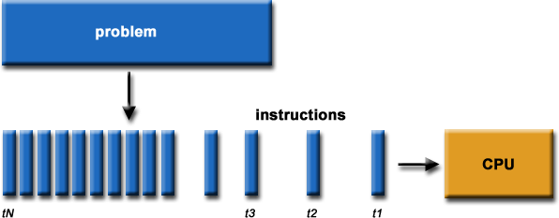
Serial computation
Traditionally software has been written for serial computation:
run on a single computer
instructions are run one after another
only one instruction executed at a time
Option:UCRL#
4

Slide 5
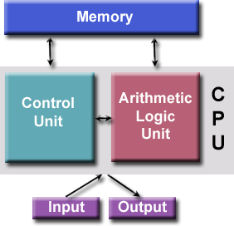
Von Neumann Architecture
John von Neumann first authored the general requirements for an electronic computer in 1945
Data and instructions are stored in memory
Control unit fetches instructions/data from memory, decodes the instructions and then sequentially coordinates operations to accomplish the programmed task.
Arithmetic Unit performs basic arithmetic operations
Input/Output is the interface to the human operator
Option:UCRL#
5

Slide 6
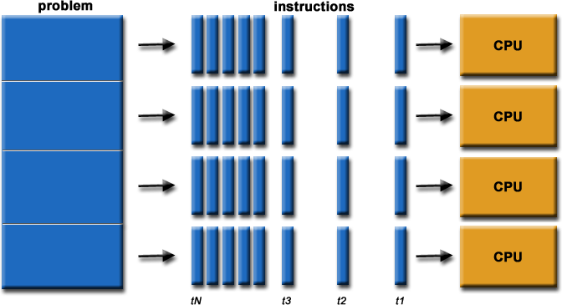
Parallel Computing
Simultaneous use of multiple compute sources to solve a single problem
Option:UCRL#
6

Slide 7
Why use parallel computing?
Save time and/or money
Enables the solution of larger problems
Provide concurrency
Use of non-local resources
Limits to serial computing
Option:UCRL#
7

Slide 8
More to understand
If we have hundred number of tree, we want to water these trees what the solution to water these trees.

Slide 9
More to understand (CONT.)

Slide 10
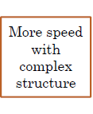

More to understand (CONT.)

Slide 11
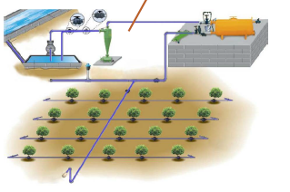
More to understand (CONT.)

Slide 12

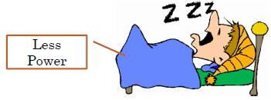
More to understand (CONT.)

Slide 13


Concepts and Terminology
Flynn’s Taxonomy (1966)
S I S D Single Instruction, Single Data | S I M D Single Instruction, Multiple Data
M I S D Multiple Instruction, Single Data | M I M D Multiple Instruction, Multiple Data
Option:UCRL#
13

Slide 14
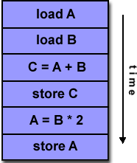
SISD
Serial computer
Deterministic execution
Examples: older generation main frames, work stations, PCs
Option:UCRL#
14

Slide 15
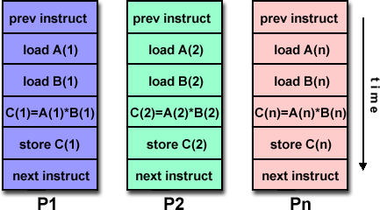
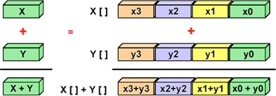
SIMD
A type of parallel computer
All processing units execute the same instruction at any given clock cycle
Each processing unit can operate on a different data element
Two varieties: Processor Arrays and Vector Pipelines
Most modern computers, particularly those with graphics processor units (GPUs) employ SIMD instructions and execution units.
Option:UCRL#
15

Slide 16
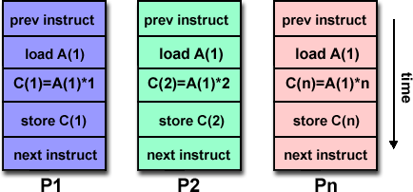
MISD
A single data stream is fed into multiple processing units.
Each processing unit operates on the data independently via independent instruction streams.
Few actual examples : Carnegie-Mellon C.mmp computer (1971).
Option:UCRL#
16

Slide 17
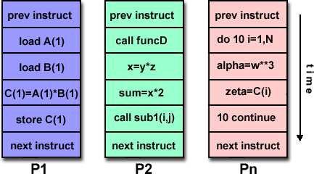
MIMD
Currently, most common type of parallel computer
Every processor may be executing a different instruction stream
Every processor may be working with a different data stream
Execution can be synchronous or asynchronous, deterministic or non- deterministic
Examples: most current supercomputers, networked parallel computer clusters and "grids", multi-processor SMP computers, multi-core PCs.
Note: many MIMD architectures also include SIMD execution sub-components
Option:UCRL#
17

Slide 18
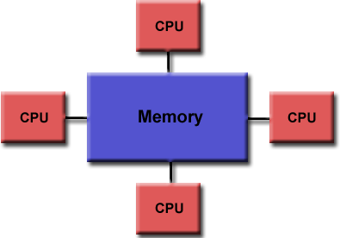
Parallel Computer Architectures
Shared memory:
all processors can access the same memory
Uniform memory access (UMA):
identical processors
equal access and access times to memory
Option:UCRL#
18

Slide 19
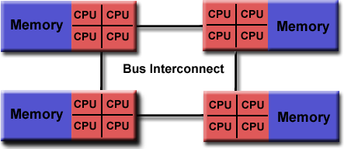
Non-uniform memory access (NUMA)
Not all processors have equal access to all memories
Memory access across link is slower
Advantages:
user-friendly programming perspective to memory
fast and uniform data sharing due to the proximity of memory to CPUs
Disadvantages:
lack of scalability between memory and CPUs.
Programmer responsible to ensure "correct" access of global memory
Expense
Option:UCRL#
19

Slide 20
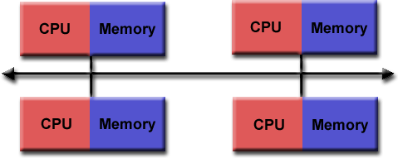
Distributed memory
Distributed memory systems require a communication network to
connect inter-processor memory.
Advantages:
Memory is scalable with number of processors.
No memory interference or overhead for trying to keep cache coherency.
Cost effective
Disadvantages:
programmer responsible for data communication between processors.
difficult to map existing data structures to this memory organization.
Option:UCRL#

Slide 21
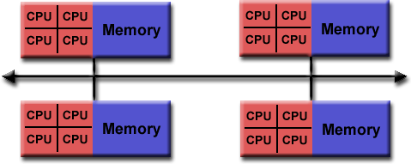
Hybrid Distributed-Shared Meory
Generally used for the currently largest and fastest
computers
Has a mixture of previously mentioned advantages and disadvantages
Option:UCRL#

Slide 22
Parallel programming models
Shared memory
Threads
Message Passing
Data Parallel
Hybrid
All of these can be implemented on any architecture.
Option:UCRL#

Slide 23
Shared memory
tasks share a common address space, which they read and write asynchronously.
Various mechanisms such as locks / semaphores may be used to control access to the shared memory.
Advantage: no need to explicitly communicate of data between tasks -> simplified programming
Disadvantages:
Need to take care when managing memory, avoid
synchronization conflicts
Harder to control data locality
Option:UCRL#

Slide 24
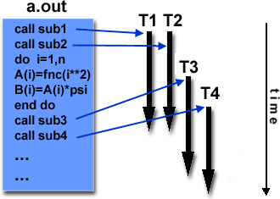
Threads
A thread can be considered as a subroutine in the main program
Threads communicate with each other through the global memory
commonly associated with shared memory architectures and operating systems
Option:UCRL#

Slide 25
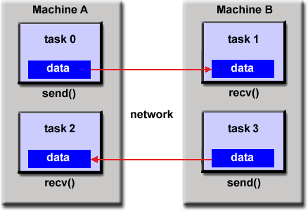
Message Passing
A set of tasks that use their own local memory during computation.
Data exchange through sending and receiving messages.
Data transfer usually requires cooperative operations to be performed by each process.
For example, a send operation
must have a matching receive operation.
MPI (released in 1994)
MPI-2 (released in 1996)
Option:UCRL#

Slide 26
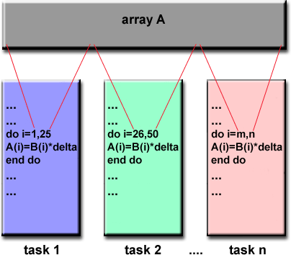
Data Parallel
The data parallel model demonstrates the following characteristics:
Most of the parallel work performs operations on a data set, organized into a common structure, such as an array
A set of tasks works collectively on the same data structure, with each task working on a different partition
Tasks perform the same operation on their partition
On shared memory architectures, all tasks may have access to the data structure through global memory. On distributed memory architectures the data structure is split up and resides as "chunks" in the local memory of each task.
Option:UCRL#

Slide 27
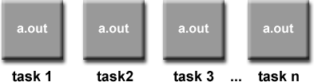
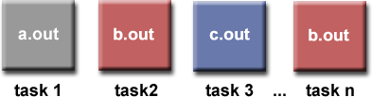
Other Models
Hybrid
combines various models, e.g. MPI/OpenMP
Single Program Multiple Data (SPMD)
A single program is executed by all tasks simultaneously
Multiple Program Multiple Data (MPMD)
- An MPMD application has multiple executables. Each task can execute the same or different program as other tasks.
Option:UCRL#

Slide 28
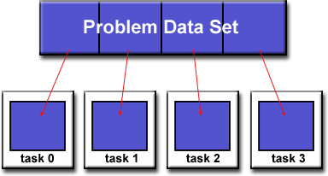
Designing Parallel Programs
Examine problem:
Can the problem be parallelized?
Are there data dependencies?
where is most of the work done?
identify bottlenecks (e.g. I/O)
Partitioning
How should the data be decomposed?
Option:UCRL#

Slide 29
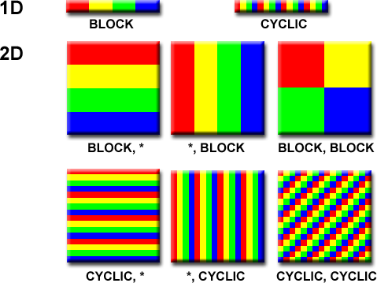
Various partitionings
Option:UCRL#

Slide 30
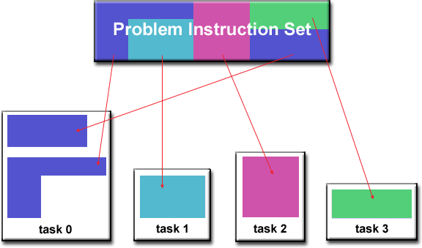
How should the algorithm be distributed?
Option:UCRL#

Slide 31
Synchronization types
Barrier
Each task performs its work until it reaches the barrier. It then stops, or "blocks".
When the last task reaches the barrier, all tasks are synchronized.
Lock / semaphore
The first task to acquire the lock "sets" it. This task can then
safely (serially) access the protected data or code.
Other tasks can attempt to acquire the lock but must wait until the task that owns the lock releases it.
Can be blocking or non-blocking
Option:UCRL#

Slide 32
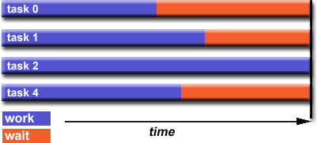
Load balancing
Keep all tasks busy all of the time. Minimize idle time.
The slowest task will determine the overall performance.
Option:UCRL#

Slide 33
THEORETICAL BACKGROUND

Slide 34


Speedup & Parallel Efficiency
Speedup:
₌ T_{s}
S
p
T
super-linear speedup
p
p = # of processors
Ts = execution time of the sequential algorithm
Tp = execution time of the parallel
algorithm with p processors
Sp= P (linear speedup: ideal)
Sp
linear speedup
normal speedup
Parallel efficiency
T_{s}
# of processors
E = ^{S p} =
p
p pT
p

Slide 35
Limits of Parallel Computing
Theoretical Upper Limits
Amdahl’s Law
Practical Limits
Load balancing
Non-computational sections
Other Considerations
time to re-write code

Slide 36
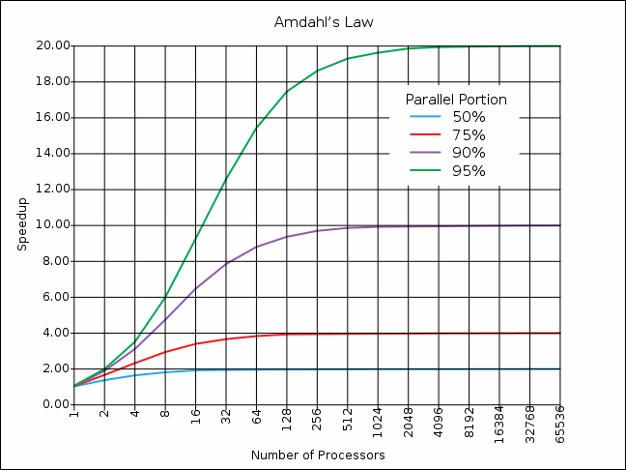
Amdahl’s Law

Slide 37
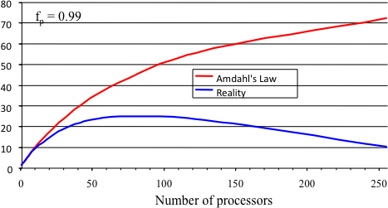
Practical Limits: Amdahl’s Law vs. Reality
In reality, the situation is even worse than predicted by Amdahl’s Law due to:
Load balancing (waiting)
Scheduling (shared processors or memory)
Cost of Communications
I/O
Sp

